Slide 1

인텔리제이
인텔리제이 JSTL maven추가

Slide 2
<!-- JSP API -->
<dependency>
<groupId>jakarta.servlet.jsp</groupId>
<artifactId>jakarta.servlet.jsp-api</artifactId>
<version>3.0.0</version>
<scope>provided</scope>
</dependency>
<!-- JSTL API -->
<dependency>
<groupId>org.glassfish.web</groupId>
<artifactId>jakarta.servlet.jsp.jstl</artifactId>
<version>2.0.0</version>
</dependency>

Slide 3
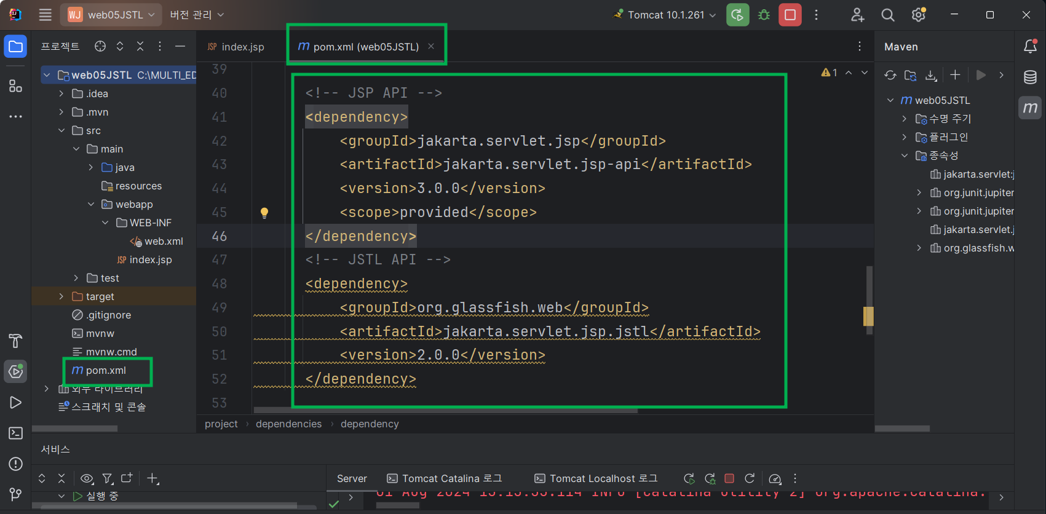

Slide 4
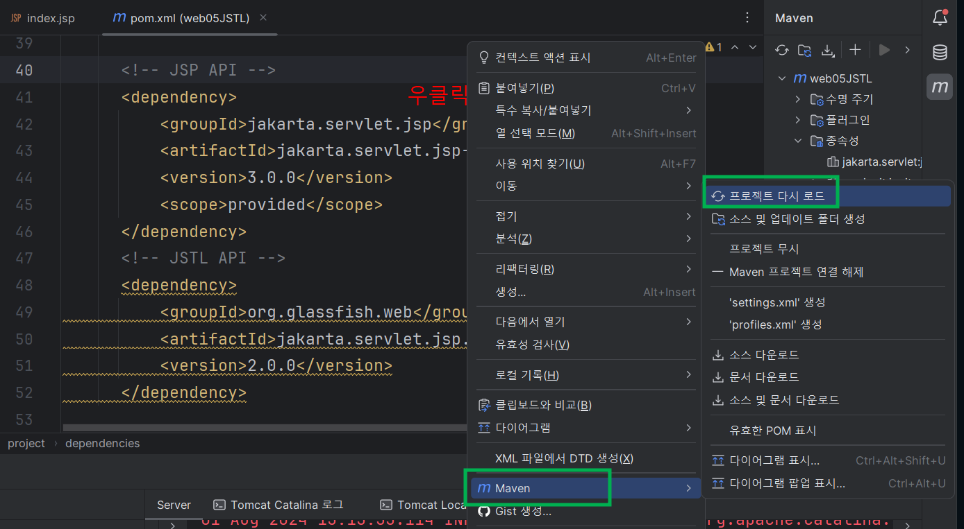

Slide 5
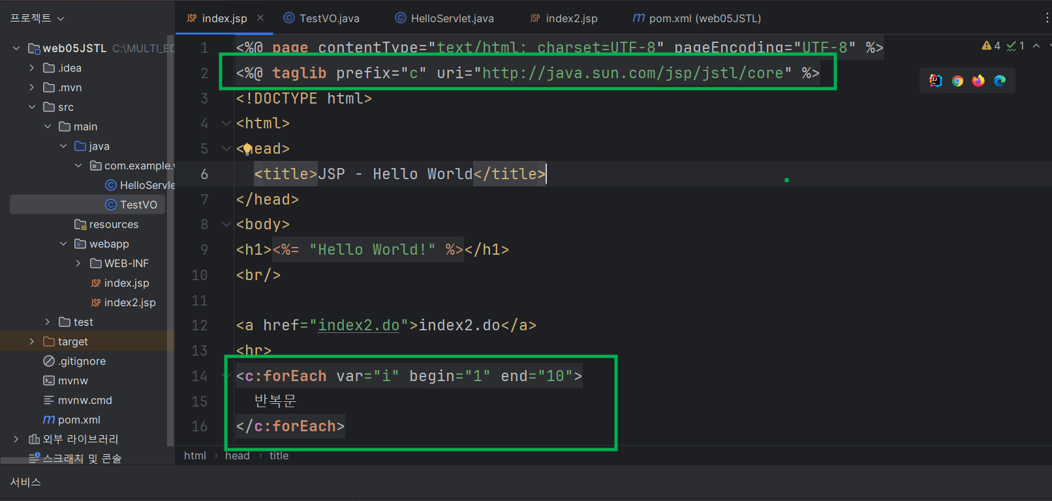

Slide 6
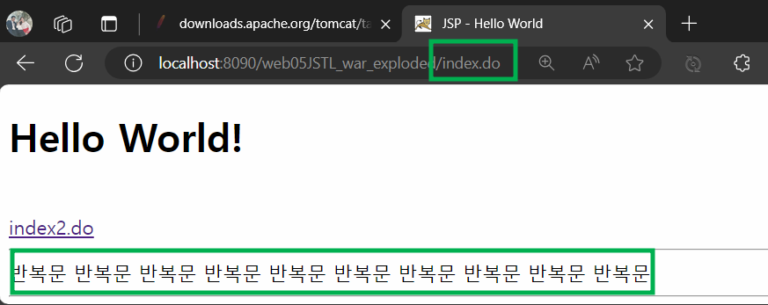

Slide 7
수고하셨습니다.

